Slide 1
Generic Sensory Prediction
Bill Softky
Telluride Neuromorphic Engineering Workshop
Summer 2011
Notes:
In 1985, over half a lifetime ago, I was working the physics dept of Bell Labs when I played hooky for a seminar honoring a fellow employee, John Hopfield. Presentations on “Hopfield Nets” and parallel analog computions showed me a “neuron” for the first time, and soon I dedicated my life to understanding how straightforward, interconnected units could spontaneously give rise to learning, generalization, prediction, and guided behavior.

Slide 2
----------------- Abstract trends -----------------
Feedforward “compression”
Predictive feedback
----------------- raw sensory stream ---------------
Notes:
This talk is in that spirit, but since I’m more confident in our understanding of the sensory problem-space than in our understanding of single neurons and hypercolumns, I’m investigating the behavior of a simple-as-possible single *algorithmic* unit (not a neural unit). Many such “generic prediction” units could be stacked to produce brain-like generalizations and predictions at multiple scales of space and time, with the slowest and most abstract at the top, and the most fine-grained at the bottom “pixel” level.

Slide 3
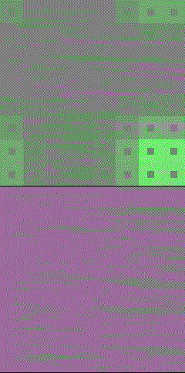

Today: ONE compressor.
Use the white images to predict the moving green ones
Notes:
But no hierarchy today; just one unit. Today’s whole task—and the entire result—is shown at right: the Compressor is exposed to moving “green” pixel images (typically an 8x8 grid) at all possible directions and positions, and from those it learns, unsupervised, to predict that motion well beyond the current frame, as shown by the white images below, which are superposed in the white dots above. (HINT: to see the animation, view this slide in “SlideShow” mode, not editing mode.)

Slide 4
Axioms
Trans-modality: light, sound, tactile
Temporal
Unsupervised
Spatiotemporal compression
Strictly non-linear problem
Fake data for ground-truth validation
Notes:
This module is supposed to predict any kind of continuously-changing input across TIME (not mere static reconstruction), from scratch, while distilling the current state and trajectory for potential use by other modules. Because the first task is to make sure the module gets the *right* answer, I’m testing it first against simplified fake low-dimensional data whose structure I know exactly.

Slide 5
Tricks
Reversible piece-wise linear interpolation/extrapolation
Represent sub-manifold
Compress space and time separately
Sparse
CPU-intensive (for now)
”Hello World” reference implementation
Notes:
Because my goal is to test and understand a first-guess simple module—not a perfect one—there are literally dozens of quick-and-dirty algorithmic tricks buried here, along with a few principled ones like those on this slide; every single part of this system can definitely be improved, because I’m starting with my hunches and biases.

Slide 6
The sensory input space
Low noise
High-dim: 8x8 = 64-pixel vector
Continuous motion 360 degrees
Constant speed
Toroidal boundary conditions
8
8
Notes:
(HINT: animate this on SlideShow). This is the kind of fake data I used, truly existing on a warped 2-dimensional surface. Some tests involved other grid sizes (5x5, 11x11) or even dimensions (e.g. a 6x6x6 box).

Slide 7
How to learn this unsupervised?
Discover/interpolate/extrapolate low-dim manifold
Discover/predict temporal evolution
Generalize across speeds
Notes:
Three steps for gathering and representing the data.

Slide 8
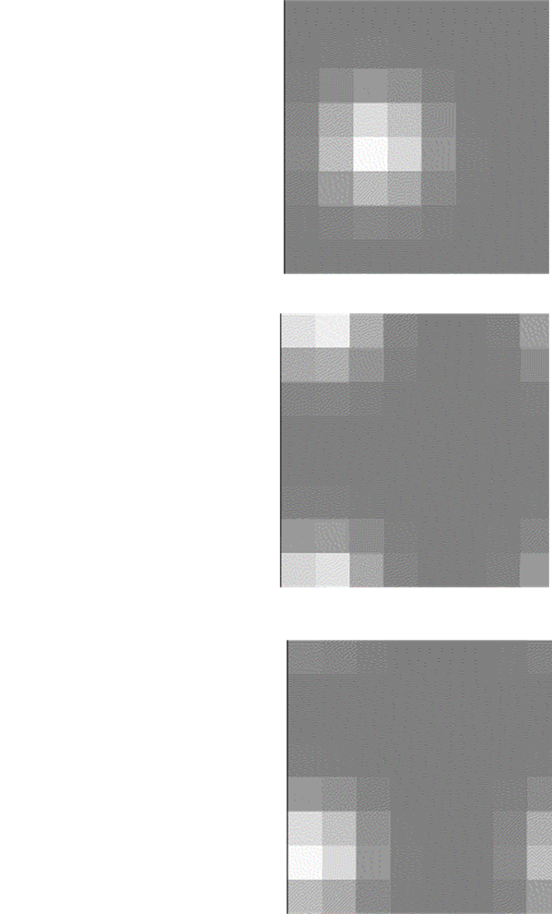
Intrinsic generating structure
Points generated from 2-d (x,y) + toroidal manifold
HIGHLY nonlinear
Y
X
Notes:
The data is generated as 2-D dots on the (x,y) manifold, convolved with Gaussians to create 64-dim blur-spots, and moved at constant velocity and slowly changing direction for 20,000 timesteps (the animations show about 200). Each frame exists as a point in 64-dim space (yellow), as if the original toroidal space were wrinkled and folded into 64-dim space like an inflated porcupine, but because we can see the grid image as flat (greyscale, at right), it’s easy to forget the “porcupine” projection is highly nonlinear.

Slide 9
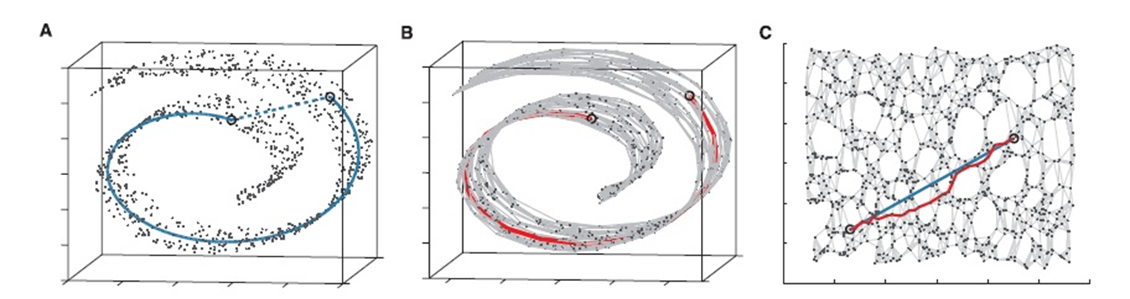
Using “Isomap” to discover manifolds
1. Points on continuous low-dim manifold embedded in N-dim
2. i) inter-point matrix D_{ij}
ii) convert to via-neighbor D_{ij}
iii) Pick top few Principal Components (u, v) as axes
u
v
3. Result: matched lists of low-dim and N-dim for each point (x₁, x₂, x₃, x₄, … x₆₄ ) ←→ (u, v)
Notes:
This classic picture illustrates Isomap, one of two dimensionality-reduction schemes used here with comparable success. Both schemes involve “flattening” points from the high-dim space into low-dim by enforcing continuous local flatness in the transformation, and both produce as outputs a list of low-dim points corresponding to each high-dim point.

Slide 10
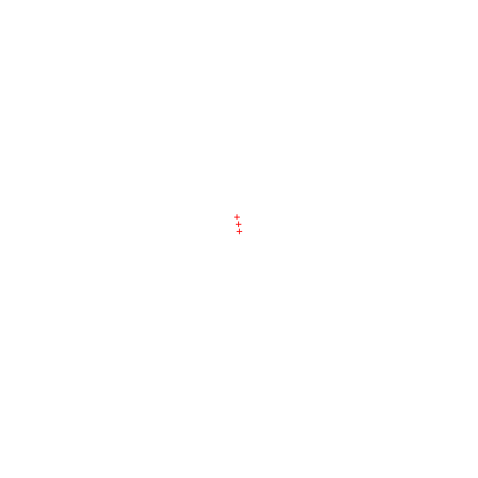
Isomap discovers toroidal point-cloud
Notes:
(HINT: animate with SlideShow ) Isomap discovered a good 3-d mapping of 1000 sample points from the 64-dim pixel space.

Slide 11
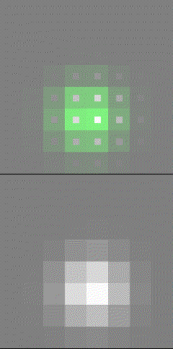
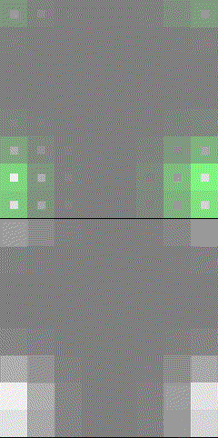
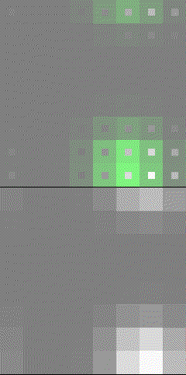
Manifold stored by 30-1000 “parallel pearl pair” table
64-dim
4-dim
Notes:
This illustrates the point-to-point mapping between low-dim and high-dim points on my “string of pearls” model for the manifold mapping.

Slide 12
Parallel paired pearl-polygon projection (“interpolation”)
Find 3 closest high-dim pearls
On their triangle, interpolate to closest match
Project to corresponding low-dim mix (same convex weights)
Notes:
This is a quick, dirty, and simple algorithm to converge on the best-possible mapping between high and low dimensions: find the closest points and their distances to your to-be-mapped probe point, do the same for their centroid, pick the three closest of those four, and repeat….usually a few iterations does great. Once you find the right weight-mix of those three points, apply the same weighting to the low-dim points to get the interpolation.

Slide 13
Bi-directional: same scheme low-dim to high-dim!
“Pseudo-inversion”? “Cleaning up”?
Notes:
Going from low to high dim follows the exact same scheme, and is guaranteed to find a point on the high-dim polygon because it’s all interpolation, through and through.

Slide 14
RECONSTRUCTION fidelity = 64-dim dot product =
Notes:
You can test the fidelity by mapping from high to low and back, and computing the dot-products of the initial and “reconstructed” points to measure fidelity. The reconstruction would be perfect (1.0) if each direction used the exact same initial points, but in fact the top-three initial points in the two spaces tend to be different, even if we would like them to be the same.

Slide 15
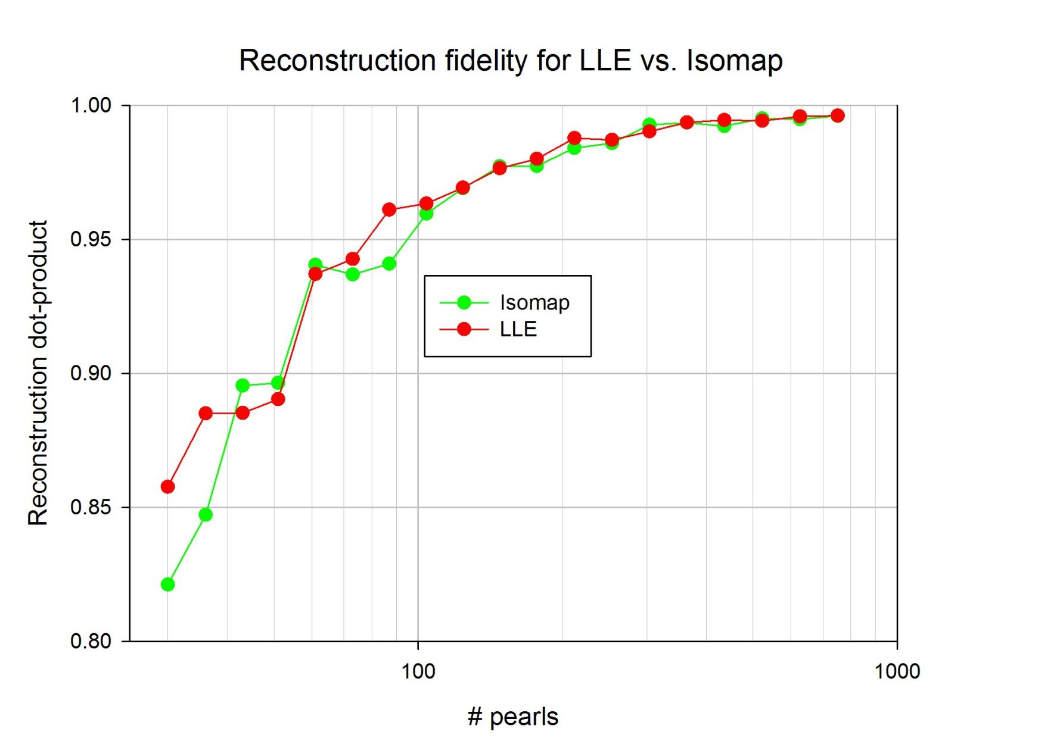
Dim-reduction recipe doesn’t matter:
Isomap ∼ Local Linear Embedding (“LLE”)
Notes:
This system needs some kind of dimensionality-reduction, but it doesn’t have to be Isomap. On this “reconstruction fidelity” metric shown here, a competitor algorithm called Local Linear Embedding (in red) performs at least as well as Isomap (green).

Slide 16
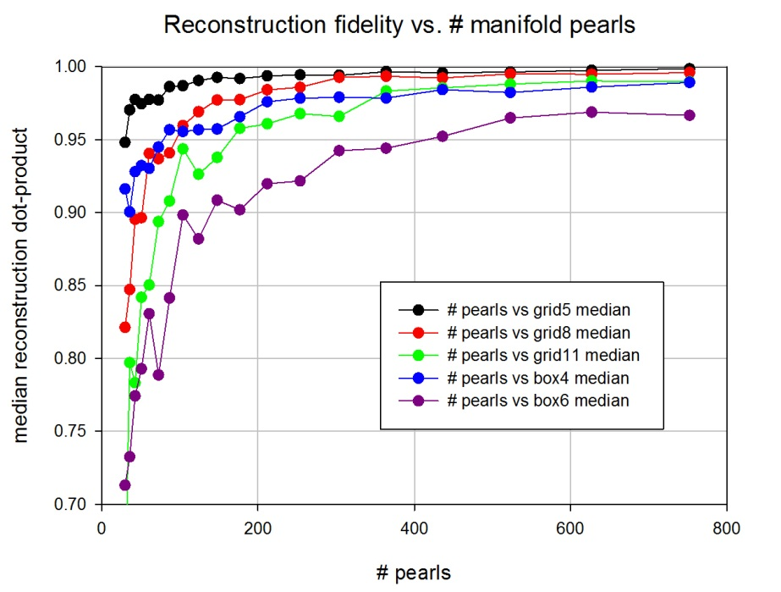
Reconstruction fidelity varies by…
# pearls
Manifold & sensory dimension
“grid” d=2 | 5 x 5 | 8 x 8 | 11 x 11
“box” d=3 | 4 x 4 x 4 | 6 x 6 x 6
Why?
Notes:
This tests reconstruction fidelity (dot product, on vertical axis) across several variables at once: the number of pearls, the dimension of the generating manifold (2-d grid vs. 3-d box), and the actual dimensions (4x4x4 to 11x11). This shows the raw data; the next two show a simple explanation for most of the variability.

Slide 17
Scaling heuristic: minimum “pearls per axis”
(low-D + 1) points define local interpolation (cont’s plane/polygon)
# axes = {25, 64, 121}
Min # pearls = (low-D + 1 ) X (#axes)
Notes:
We want to understand how many pearls a given input space *ought* to have. A simple proposal is “a few pearls per axis”, with an initial candidate for “a few” being “one more than the low-dimension,” so they can describe a hyperplane there. This is our estimate for the “minimum number of pearls” for good reconstruction fidelity.

Slide 18
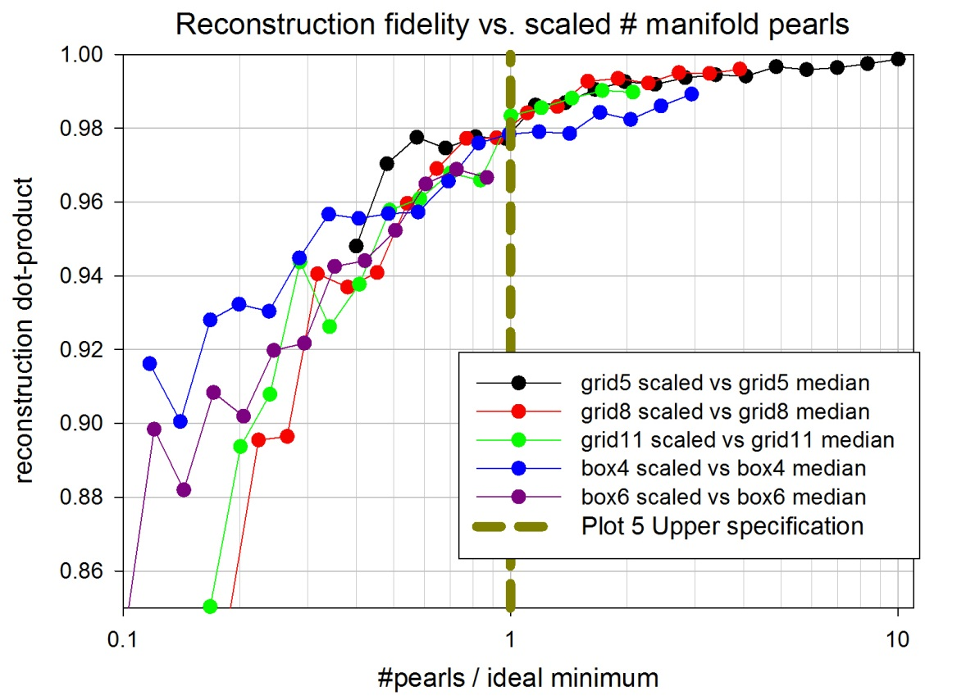
#pearls > min-pearls ➔ good reconstruction
Notes:
Taking the earlier raw data, and rescaling the x-axis by the minimum pearls, gives this much-more-consistent view: representation is “good” (98%) at and above the minimum number of pearls, so it looks like we indeed mostly understand what’s going on.

Slide 19
EXTRAPOLATION fidelity = 64-dim dot product
= actual vs. “constant velocity”
extrapolation
actual
“constant velocity” extrapolation
Notes:
Now we’ll repeat the same reconstruction-fidelity measurement, but with a twist: using extrapolation rather than interpolation. We start with TWO points in the high-dim space. The “actual” extrapolation is given by the generating function from (x1,y1) past (x2,y2) to get (x3, y3); the “constant velocity” extrapolation is the same math applied to the low-dim mappings of those two initial points, then mapped back into high-dim. Do those two different high-dim extrapolated points line up?

Slide 20
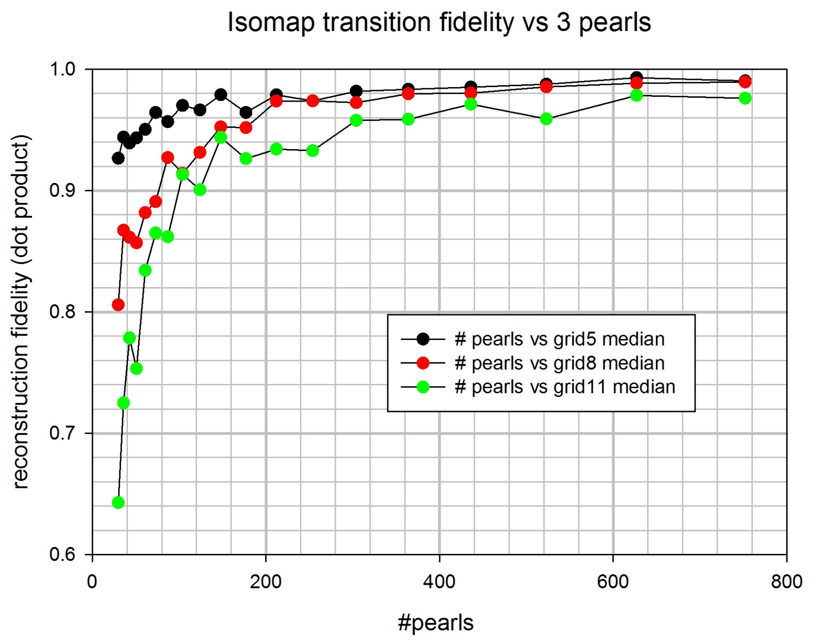
For prediction, measure extrapolation fidelity:
Notes:
Same style graph as before, but for extrapolation.

Slide 21

Scaling redux: minimum “pearls per axis”
….now curved saddle (not plane) for continuous derivative
(low-D + 3) points define local saddle
# axes = {25, 64, 121}
Min # pearls = (low-D + 3 ) X (#axes)
Notes:
Same “minimum pearls” idea as before, but now with D+3 points (describing a saddle to accommodate curvature) rather than D+1.

Slide 22
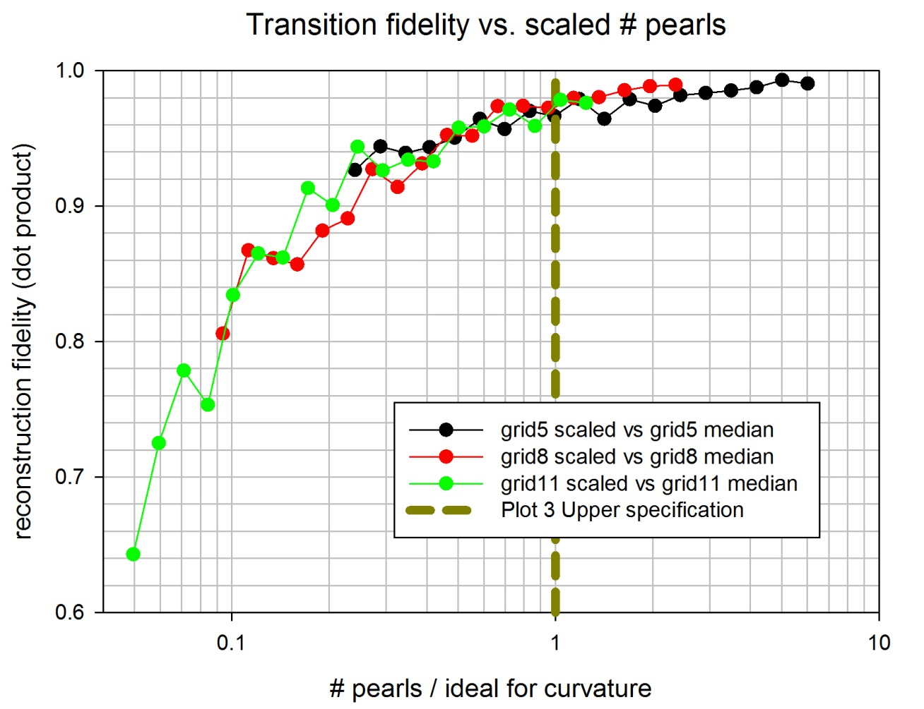
#pearls > Min-pearls ➔ good reconstruction
.97
1.0
Notes:
Same rescaling as before (by the “new” minimum pearls for this extrapolation task), with the same basic result: everything gets good at and above the minimum number of pearls.

Slide 23
Discover/interpolate/extrapolate manifold
Discover/predict temporal evolution
Generalize across speeds
Notes:
One task down, two to go.

Slide 24
Local “motion” extrapolation needs state+direction
Bi-linear “Reichart detector” A x B ➔ D
Now: tril-linear mapping A x B x C ➔ D
D
D’
A
B
A’
D
C
B
A
Notes:
Now that we can map to a reasonably low dimension, we can try extrapolating arbitrary non-linear motion there. As Reichart showed, motion is only captured by a *product* of two state vectors (A→B != A’→B), so representing motion takes at least an outer product of two vectors. I’m choosing the triple-product (one more outer product) for a more fine-grained approach, but anything more than 2 would technically do.

Slide 25
Cross/outer product ➔ tri-linear vector
equal time-intervals
A x B x C = 4x4x4 = 64-dim
C
B
ΔT
A
ΔT
A₁
A₂
A₃
A₄
B₁
B₂
B₃
B₄
B₁
B₂
B₃
B₄
B₁
B₂
B₃
B₄
B₁
B₂
B₃
B₄
C₁
C₂
C₃
C₄
C₁
C₂
C₃
C₄
C₁
C₂
C₃
C₄
C₁
C₂
C₃
C₄
C₁
C₂
C₃
C₄
C₁
C₂
C₃
C₄
C₁
C₂
C₃
C₄
C₁
C₂
C₃
C₄
C₁
C₂
C₃
C₄
C₁
C₂
C₃
C₄
C₁
C₂
C₃
C₄
C₁
C₂
C₃
C₄
C₁
C₂
C₃
C₄
C₁
C₂
C₃
C₄
C₁
C₂
C₃
C₄
C₁
C₂
C₃
C₄
Notes:
Here’s how you actually make a triple-outer-product vector from its components. Nothing special here.

Slide 26
Accumulate linear “transition matrix”
  A x B x C ➔ D
  4 x 4 x 4=64-dim ➔ 4-dim
  (like 4th-rank tensor, 3rd-order Markov)
  Accumulate every outer product
  {A x B x C, D}
D
(4-dim out)
D
A x B x C
A x B x C
(64-dim in)
Notes:
Now that we have the triple-outer-product vectors—which we hope will produce a linear prediction of the next state—we accumulate a transition matrix from the consituent outer products of all the triplet-to-final pairs we see.

Slide 27
Make one prediction for state D(t)
  Choose many recent triplets with different ΔT
  Use all recent history
A₁
B₁
C₁
D₁(t)
ΔT₁
ΔT₁
ΔT₁
A₂
B₂
C₂
Average these to predict D(t)
D₂(t)
ΔT₂
ΔT₂
ΔT₂
A₃
B₃
C₃
D₃(t)
ΔT₃
ΔT₃
ΔT₃
Transition matrix
Notes:
Once we have the accumulated transition matrix, we can use it with ALL the data we have at any one instant, by matrix-multiplying many different D(t) final predictions (from different delay intervals on the recent history) and then averaging those independent predictions to make the most robust possible final prediction.

Slide 28
30 paired-pearls:
  “bad” prediction
  Avg accuracy 0.50
Notes:
Here’s a sample “bad” prediction, using not enough pearls. (HINT: animate with SlideShow) Notice how the white prediction jumps around, since there aren’t enough pearls for it to have a smoothly-moving prediction.

Slide 29
1000 paired-pearls:
  “good” prediction
  Avg accuracy 0.97
Notes:
Here’s a “good” prediction; the white prediction moves smoothly.

Slide 30
Discover/interpolate/extrapolate manifold
Discover/predict temporal evolution
Generalize across speeds
Notes:
Two down, one to go.

Slide 31
“Speed invariance”
Learn on one “speed”
Assume transitions apply to all speeds
Rescale ΔT by d/dt(raw distance)
fast
dist{ X(t) - X(t-Δt)
slow
Δt
Notes:
The idea of “speed invariance” is that sequences learned at one speed can be used for predictions at *other* speeds, or variable speeds. In this case “speed” does not mean in the original 2-d space of the low-dim manifold (which isn’t accessible as the transition matrix is recorded), but in the dot-product-distance metric on the high-dim space, which is always available; “speed” here means the rate of change of dot-product (or rather, 1 – dotproduct) with time. “Invariance” just means that the time-delays used in predicting are scaled by the speed, so that low speeds use longer time-delays, and faster speeds use shorter ones.

Slide 32
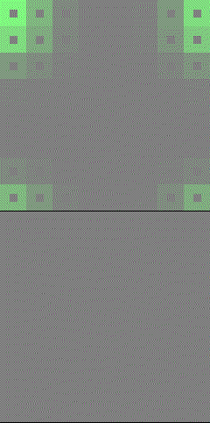
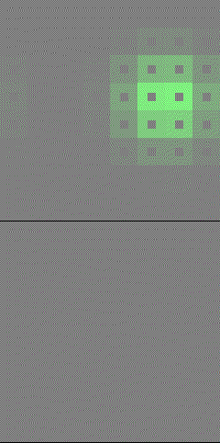
Learned
speed
Half-speed
Double-speed
Notes:
Once we automatically correct for speed, the module will do a pretty-good job of predicting at the new speed, although it has never seen that speed before. This works for both lower and higher speeds, by at least a factor of two, as shown above.

Slide 33
Discover/interpolate/extrapolate manifold
Discover/predict temporal evolution
Generalize across speeds
Notes:
All done!

Slide 34
Future Directions
Echo-cancelling (“go backwards in time”)
Sudden onset
Multiple objects
Control
Hierarchy
Current needs:
Cool demo problems w/”ground truth”
Haptic? Rich structure?
Helpers!
Notes:
Not only can and must this system be improved in its current sub-algorithms, but there is lots of room for extension of the concepts: to reverberations (like independent-component analysis in echoic rooms), non-continuous-time events, etc. Especially important is the inclusion of muscles/effectors, so that each module not only predicts the future but affects it too. But personally and structurally, what I need now is more collaborators, so this is no longer a near-solo project.

